Slide 1
CSS448 – Introduction to Compilers
x64 : Architecture & Assembler
Compiler Phases
CPU Architecture (Registers, Memory, Instructions)
yasm : convert assembly program into binary, x64, object code
gcc -lc : linking our object code with the C library
gdb : interactive debugging : stepping thru our program
<number>
Introduction To Compilers : Assembler

Slide 2
Modified Compiler Phases
Introduction To Compilers : Assembler
<number>

Slide 3
Compiler Phases
BackEnd
chars
Lexer
tokens
Parser
AST
Semantic
Checker
AST
AST to IR
IR
source
target
Above we see the familiar picture of Compiler phases
In this lecture, we will describe a very simple Backend: just a single phase that emits Assembly code directly
This lecture provides enough background in Assembly code to understand what’s going on
Introduction To Compilers : Assembler
<number>

Slide 4
Code Generation
Lexer
Parser
Sem.Check
CodeGen
chars
Tokens
AST
AST
Assembly Code
Our focus, then, is on the red boxes: from the program’s AST, generate a text file of x64 Assembly code
<number>
Introduction To Compilers : Assembler

Slide 5

Don’t Panic!
The aim of this lecture is for us to understand basic Computer Architecture and Assembly code
We are intestested in concepts, rather than detail. The aim is to appreciate how a computer works at the lowest level. This is a near-to-last step in the introduction to how Compilers work
If you have already studied CSS 422 : “Hardware and Computer Organization” this will be easy
The aim is not to become Assembler programmer gurus. That would take a little more time.
<number>
Introduction To Compilers : Assembler

Slide 6
The Pipeline
yasm is a free Assembler program for x64
fun main =
a:num
b:num
c:num
let a = 2
let b = 3
let c = a + b
ret 0
nuf
segment .text
global main
main:
mov rax, 2
mov rbx, 3
add rax, rbx
mov eax, 0
ret
01010011101010011000000100111100000101010001000100000100001100100100001111100011000001010011101010101101110101111010011010011101
Compiler
Assembler
001010011101010101101110101111010011010011101
Linker
togc
yasm
gcc -lc
add.o
add.s
add.exe
add.tog
Source Code
Assembly
Code
Object
Code
Machine
Code
<number>
Introduction To Compilers : Assembler

Slide 7
Computer Architecture
Introduction To Compilers : Assembler
<number>

Slide 8
Simplified Computer Architecture
Processor, or “chip”
x86 – very old PC
x64 – new PC
Apple A9 (ARM) - iPhone
ARM Cortex – Raspberry Pi
ATmel – Arduino
CPU
Source program, in memory, is processed by the Compiler: Lex, Parse, Check, Codegen, Assemble, Link. All intermediate results are stored in memory. The final result (linked executable) is stored as a file back on disk
Bus
Controller
Memory
(Instructions + Data)
Source program is copied from disk into memory (RAM)
eg: utFileRead
Source program is stored on a file on disk
Disk
<number>
Introduction To Compilers : Assembler

Slide 9
CPU and Memory
CPU
The CPU holds a few, very fast, cells of memory called Registers. In x64, just 16 Registers (100 bytes)
The CPU is connected to Memory
Memory
(RAM)
Typical size of Memory in a laptop is 4 GB (4e9 bytes)
The amount of data the CPU can hold in its Registers is absolutely tiny, compared with that of Memory
How to visualize a KByte or MByte or GByte
<number>
Introduction To Compilers : Assembler

Slide 10
Digression : How to Visualize Memory Sizes
Suppose 1 byte holds 1 letter of the alphabet
Suppose we squeeze each letter into a space 1 mm wide (40 ‘thou’, or about 3/64 inch)
This text is tiny. It is meant to illustrate typing so small that each character takes up only 1 mm of horizontal space. We are using Calibri type font at a size of 8 point.
1 KByte  1 m of text 3 feet
1 MByte  1 km of text 0.6 miles Husky Hall to Highway 522
1 GByte  1,000 km of text 620 miles Seattle to Spokane, and back
1 TByte  1,000,000 km of text 620,000 miles 25 times around the earth
Introduction To Compilers : Assembler
<number>

Slide 11
CPU and Memory : Detail
CPU Registers
Typically 16 x 64-bit
Access time ~1 nsec
Typical sizes for a modern x64 laptop
Registers are ~ 150 times faster than RAM memory
Typically 3 MB
Access Time ~10 nsec
Cache
Memory (RAM)
Typically 8 GB
Access Time ~ 150 nsec
150 times slower?
1 second compared with 2.5 minutes
Disk
Typically 1 TB
Non-Volatile
Access Time ~10 msec
Introduction To Compilers : Assembler
<number>

Slide 12
Questions
What are the names of some popular CPU chips (“processors”)?
Are they 8-bit, 16-bit, 32-bit or 64-bit?
How much memory can they address?
What is the most widely used chip architecture on Planet Earth?
What does 8-bit, etc, mean?
Introduction To Compilers : Assembler
<number>

Slide 13
Which Chip to Choose for our Compiler?
The assembly code, and resultant machine code, is different for each chip
Eg: code for Apple A9 (iPhone) will not run on Intel x64 (Laptop PC)
We will study Intel x64 (64-bit) code
All modern laptops have an x64 (64-bit) cpu, but can run legacy x86 Apps
Eg: you can find VisiCalc 1.0 (1979). It still runs on a modern laptop
32-bit Apps on desktop are becoming more rare:
Mac: No longer supports 32-bit Apps
Ubuntu: Need to install extra libraries to run 32-bit Apps
Windows: Supports both 32-bit and 64-bit Apps
<number>
Introduction To Compilers : Assembler

Slide 14
Digression : x64 History
Introduction To Compilers : Assembler
<number>

Slide 15
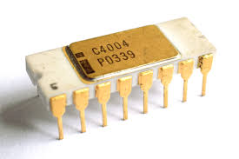
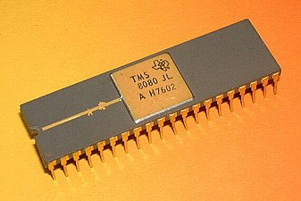
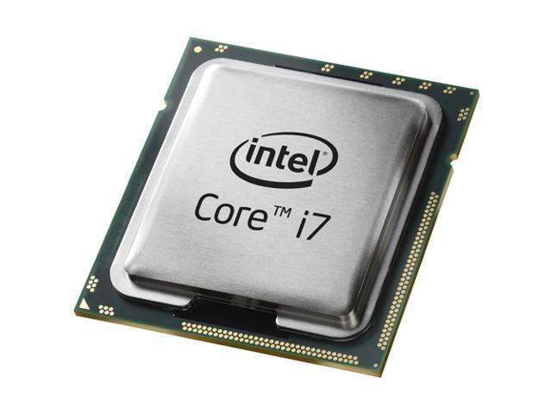
Intel/AMD Potted History
Started life as 8-bit 8080 in 1974
Evolved to 64 bit by 2006
Naming by Intel and AMD is a muddle
We will call them x86 (16 & 32-bit) or x64 (64-bit)
Naming: x86 => 8086, 80186, 80286, 80386, 80486
1971
Intel 4004
2,300 transistors
740 kHz Clock
1974
Intel 8080
6,000 transistors
3 MHz Clock
Former Names:
AMD x86-x64
AMD64
Intel EMT64
2 Billion transistors
4 cores
8 threads
4 GHz Clock
Introduction To Compilers : Assembler
<number>

Slide 16
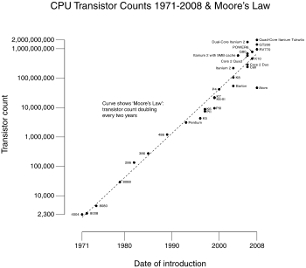
6 orders of magnitude increase in chip complexity!
Introduction To Compilers : Assembler
<number>

Slide 17
x86 Potted History
40 Years of x86
1978: 8086 16-bit, 5 MHz, 3μ, segmented
1982: 80286 protected mode, floating point
1985: 80386 32-bit, Virtual Memory
1993: Pentium MMX
1999: Pentium III SSE
2000: Pentium IV SSE3, HyperThreading
2006: Core Duo, Core2 Multicore, SSE4, x64
2013: Haswell 64-bit, 4-8 core, ~3 GHz, 22 nm, AVX2
and it just keeps getting better
Many micro-architecture changes over the years:
pipelining, super-scalar, out-of-order, caching, multicore
You don’t need to remember any of this
Introduction To Compilers : Assembler
<number>
Notes:
<number>

Slide 18
Back to CPU Architecture
Introduction To Compilers : Assembler
<number>

Slide 19
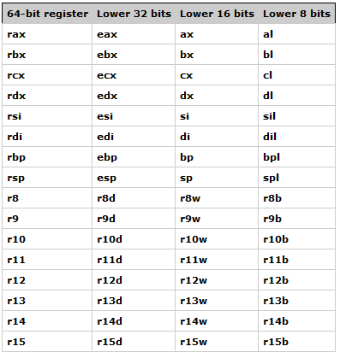
16 GPRs
Crazy Naming Scheme!
Each GPR is 64 bits (8 bytes) wide
Can access subsets of bytes:
rax
eax
ax
ah
al
Introduction To Compilers : Assembler
<number>

Slide 20
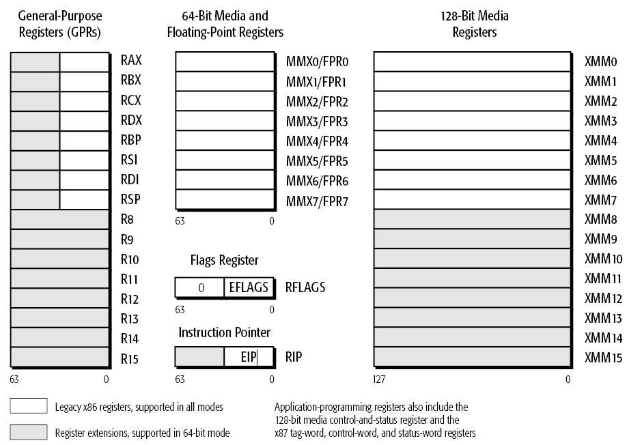
X64 Registers
16 General Purpose Registers (GPRs)
8 Floating-Point Registers (defunct)
16 SIMD registers
A few Special-Purpose Registers (RBP, RSP, RIP)
We shall need only RAX, RBX and RCX
<number>

Slide 21
X64 Special-Purpose Registers
RSP : Stack Pointer - points at top of process stack
23
48f20
Stack grows towards smaller addresses
99781
ff03
. . .
RIP : Instruction Pointer – points at the next instruction to be executed
b
???? ????
rsp
a
???? ????
RBP : Base Pointer - points into Frame of current function
old rbp
rbp
int add(int x, int y) {
int a = x; int a = y;
return a + b;
}
int main() {
int ans = add(1, 2);
return 0;
}
00A5 F988
return address
x
0000 0001
y
0000 0002
We shall cover RSP and RBP in more detail later
<number>
Introduction To Compilers : Assembler

Slide 22
Programming the x64
Introduction To Compilers : Assembler
<number>

Slide 23
Operands in Memory
Suppose we want to write assembly code for the following C instruction:
x += y
It would be nice to translate this, as follows
CPU
add [x], [y]
Memory
But x64 does not support both operands being in memory.
Instead, we will copy the operands from memory into registers and perform arithmetic on the registers
y
x
Introduction To Compilers : Assembler
<number>

Slide 24
Registers
CPU
Small chunks of memory inside the CPU
x64 has 16 (general purpose) registers
Each is 64 bits wide
Access Times:
Register: 1 clock cycle: ~1 nanosec
Main memory: 150 nanosecs
rax
rbx
rcx
Memory
y
x
Introduction To Compilers : Assembler
<number>

Slide 25
x += y, using Registers
CPU
mov rax, [x] ; load
mov rbx, [y] ; load
add rax, rbx
mov [x], rax ; store
Memory
y
x
Note : first operand is the destination
So mov rax, rbx copies value in rbx into rax
Transfer value from memory to register = LOAD
Transfer value from register to memory = STORE
Terminology
Introduction To Compilers : Assembler
<number>

Slide 26
Building Assembler Programs
with nano, yasm and gcc
Introduction To Compilers : Assembler
<number>

Slide 27
x86/x64 Assemblers
Our Tog compiler will emit Assembly code, targetting the x64 chip.
We might have hoped that all assemblers for x86/x64 would have used the same syntax. Alas no. There are two variants:
Intel/Microsoft – used by Intel docs
GNU/AT&T syntax (Linux, OS X)
Example differences:
Intel: mov ebp, esp ; destination comes first
AT&T: movl %esp, %ebp ; source comes first
We will use Intel descriptions, with the yasm assembler
Introduction To Compilers : Assembler
<number>

Slide 28
yasm?
yasm is an open-source Assembler. See https://yasm.tortall.net/
Supports x86 (16 bit and 32 bit) - but we won’t use this
Supports x64
Runs on Linux, Windows and Mac
<number>
Introduction To Compilers : Assembler

Slide 29
Following instructions will be inserted into the .text segment
Example Assembly Code
label
add.s
“main” is visible outside object file
segment .text
global main
main:
mov rax, 2
mov rbx, 3
add rax, rbx
mov eax, 0
ret
rax is destination
return value in eax
Lines like mov rax, 2 generate binary code into the output file : mov is called an op
Instructions like global main instruct the assembler : global is called a pseudo-op
Terminology
<number>
Introduction To Compilers : Assembler

Slide 30
Building the “add” program
$ nano add.s
$ yasm -f elf64 -g dwarf2 -l add.lis add.s
$ gcc -o add -lc -static add.o
$ ./add
elf = Executable and Linkable Format
-g => Inject Debug Info in dwarf2 format
-lc => link with C library
C library
add.o
x64 Object Code
add
x64 Executable Code
add.s
Assembly Code
yasm
gcc linker
add.lis
Introduction To Compilers : Assembler
<number>

Slide 31
Building the “add” program on Linux
$ yasm --help
$ gcc --help
Use the --help option to discover required syntax
$ yasm -f elf64 -g dwarf2 -l add.lis add.s
$ gcc -o add -lc -static add.o
The Answer!
Introduction To Compilers : Assembler
<number>

Slide 32
add.lis
The listing file shows:
Line number, byte address from start, assembled instruction, source line
1 %line 1+1 add.s
2 [segment .text]
3 [global main]
4 main:
5 00000000 48C7C002000000 mov rax, 2
6 00000007 48C7C303000000 mov rbx, 3
7 0000000E 4801D8 add rax, rbx
8 00000011 B800000000 mov eax, 0
9 00000016 C3 ret
Quiz
Are instructions all the same length?
How long is each instruction above (in bytes)?
How long is the shortest possible instruction?
<number>
Introduction To Compilers : Assembler

Slide 33
hexdump of add.o
00000000 7f 45 4c 46 02 01 01 00 00 00 00 00 00 00 00 00 |.ELF............|
00000010 01 00 3e 00 01 00 00 00 00 00 00 00 00 00 00 00 |..>.............|
00000020 00 00 00 00 00 00 00 00 f0 00 00 00 00 00 00 00 |................|
00000030 00 00 00 00 40 00 00 00 00 00 40 00 05 00 01 00 |....@.....@.....|
00000040 48 c7 c0 02 00 00 00 48 c7 c3 03 00 00 00 48 01 |H......H......H.|
00000050 d8 b8 00 00 00 00 c3 00 00 2e 74 65 78 74 00 2e |..........text..|
00000060 73 74 72 74 61 62 00 2e 73 79 6d 74 61 62 00 2e |strtab..symtab..|
00000070 73 68 73 74 72 74 61 62 00 00 00 00 00 61 64 64 |shstrtab.....add|
00000080 2e 73 00 6d 61 69 6e 00 00 00 00 00 00 00 00 00 |.s.main.........|
00000090 00 00 00 00 00 00 00 00 00 00 00 00 00 00 00 00 |................|
000000a0 01 00 00 00 04 00 f1 ff 00 00 00 00 00 00 00 00 |................|
000000b0 00 00 00 00 00 00 00 00 00 00 00 00 03 00 04 00 |................|
000000c0 00 00 00 00 00 00 00 00 00 00 00 00 00 00 00 00 |................|
Some machine code, some text. yasm knows how to make this format. The Linux OS Loader program understands this format. The two must match!
<number>
Introduction To Compilers : Assembler

Slide 34
Define a Bash Function
Add a function to the end of your .bashrc script to avoid repetitive typing!
$ nano ~/.bashrc
function asmlnk() {
yasm –f elf64 –g dwarf2 -l"$1".lis "$1".s;
gcc -o "$1" -lc -static "$1".o;
}
Relaunch the terminal window, to pick up this function, and now:
$ asmlnk add
Introduction To Compilers : Assembler
<number>

Slide 35
Don’t Panic, Again!
Every program we build in x64 assembly code will follow the same pattern as add.s
Every x64 assembly program will use the same yasm and gcc link commands
For the Tog compiler, we will only ever use 3 GPRs: rax, rbx and rcx
Later, when we call functions, we will use the Stack Pointer rsp, and the Base Pointer, rbp
<number>
Introduction To Compilers : Assembler

Slide 36
Tutorials/Books for x64 Assembler?
The lecture slides will cover all the concepts and instructions we need.
If you want further background, then below are a couple of free, online tutorials.
Beware: avoid tutorials/books that spend all their time on x86, with only a mention of x64 at the end
Beware: there are two syntaxes for x86/x64 assembly code. (Intel/Microsoft versus Unix/AT&T)
Note that the following links provide much, much more info than we will need for this course!
Example Online Tutorials:
https://software.intel.com/en-us/articles/introduction-to-x64-assembly
https://www.tutorialspoint.com/assembly_programming/assembly_tutorial.pdf
<number>
Introduction To Compilers : Assembler

Slide 37
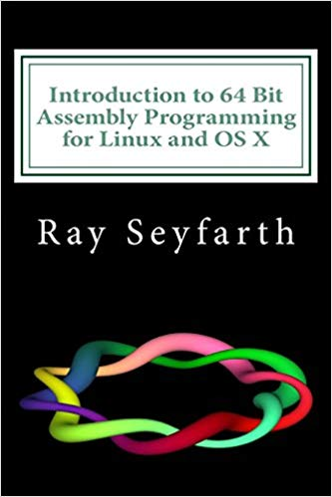
Book for x64 Assembler?
In paperback ($23) and Kindle
A gentle, but thorough treatment
(Again, much more info than we will need)
<number>
Introduction To Compilers : Assembler

Slide 38
add3 : Fun with yasm
Introduction To Compilers : Assembler
<number>

Slide 39
More x64 Assembly Code
Line-oriented
Semicolon starts a line comment
x: and y: and main: are labels
Types of instruction:
Directive to yasm (eg: “segment”)
Data declaration (eg: “dq”)
Instruction (eg: “add rax, rbx”)
.data => read/write memory
dq => define quadword (8 bytes)
.text => readonly memory (instructions)
global => visible to Linker
mov => move data
[x] => contents of x (not its address)
xor rax, rax ; small and fast
memadd.s
segment .data
x: dq 175
y: dq 4097
segment .text
global main
main:
mov rax, [x] ; load x
mov rbx, [y] ; load y
add rax, rbx
mov [x], rax ; store
xor rax, rax ; rax = 0
ret
<number>
Introduction To Compilers : Assembler

Slide 40
yasm Statements
Format is
label: opcode operands ; comment
label is an optional label
opcode and operands make up the assembly language instruction
Anything following a ; is a comment
Comments and labels may appear on lines by themselves
Introduction To Compilers : Assembler
<number>

Slide 41
Bytes, etc
To instruct yasm to reserve 8 bytes of space in memory, and give that cell a name, we use the dq pseudo-op.
There are pseudo-ops for smaller cells, but we won’t need them
Name | Bits | Bytes | yasm
byte | 8 | 1 | db
word | 16 | 2 | dw
dword | 32 | 4 | dd
qword | 64 | 8 | dq
<number>
Introduction To Compilers : Assembler

Slide 42
Practice
Write an x64 Assembly Program, called add3
Define 3 variables a, b and c in the .data section
Each variable should be 64-bits long (dq)
Assign them any values you want
Load each variable into a different GPR
Add all 3 registers into a fourth register
Return that sum in rax
Use yasm to assemble add3.s into add3.o
Use gcc linker to create add3
Run add3
Did it work?
<number>
Introduction To Compilers : Assembler

Slide 43
Answer : add3.s
segment .data
a: dq 123
b: dq 456
c: dq 789
segment .text
global main
main: mov rax, [a]
mov rbx, [b]
mov rcx, [c]
mov rdx, 0
add rdx, rax
add rdx, rbx
add rdx, rcx
mov rax, rdx
ret
$ nano add3.s
$ asmlnk add3
$ ./add3
$ echo $?
$? is return value of last Bash command
Answer should be 1368. But $? says 88! How do we debug add3?
<number>
Introduction To Compilers : Assembler

Slide 44
gdb
Introduction To Compilers : Assembler
<number>

Slide 45
How to ‘watch’ the add program running?
add3.s contains no print statement
So how do we know what’s going on inside?
How can we ‘watch’ it running?
<number>
Introduction To Compilers : Assembler

Slide 46
gdb - GNU Debugger
gdb
$ gdb add3
(gdb) list
(gdb) break 8
(gdb) run
(gdb) nexti
(gdb) info registers
(gdb) ...
add3
X64 PC
<number>
Introduction To Compilers : Assembler

Slide 47
Practice : Run add3 under gdb
Use list to see the beginning of your program
Type list again - what happens?
How do you list lines 5 thru 10?
Set a breakpoint on last line
Type run
Show contents of register rax, rbx and rcx
Explore help
Find abbreviations for nexti, break
Explore info
Step thru add3 and discover if there’s a bug!
<number>
Introduction To Compilers : Assembler

Slide 48
Run add3 under gdb : Answer
list lines 1..10
Use list to see the beginning of your program
Type list again - what happens?
How do you list lines 5 thru 10?
Set a breakpoint on last line
Type run
Show contents of register rax, rbx and rcx
Explore help
Find abbreviations for nexti, break
Explore info
list lines 11..17
list 5, 10
break 17
info registers rax
ni, b
<number>
Introduction To Compilers : Assembler

